Slide 1
Power in Particle Systems
Dr. Jacob Moore
Associate Professor of Engineering
Penn State Mont Alto

Slide 2
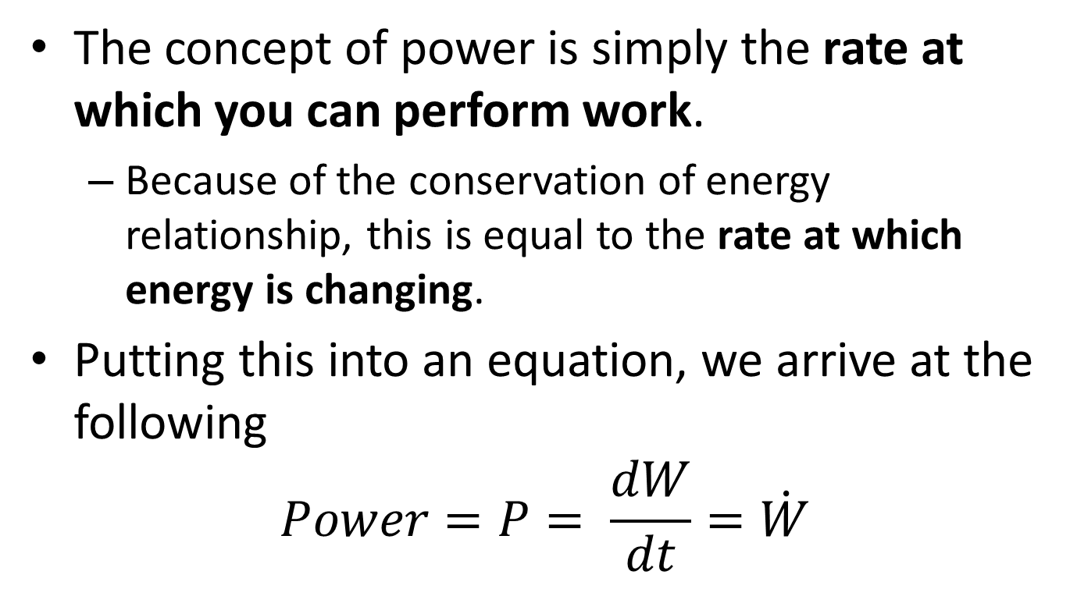
Power
The concept of power is simply the rate at which you can perform work.
Because of the conservation of energy relationship, this is equal to the rate at which energy is changing.
Putting this into an equation, we arrive at the following
$$Power=P= \frac{dW}{dt}=\dot{W}$$

Slide 3
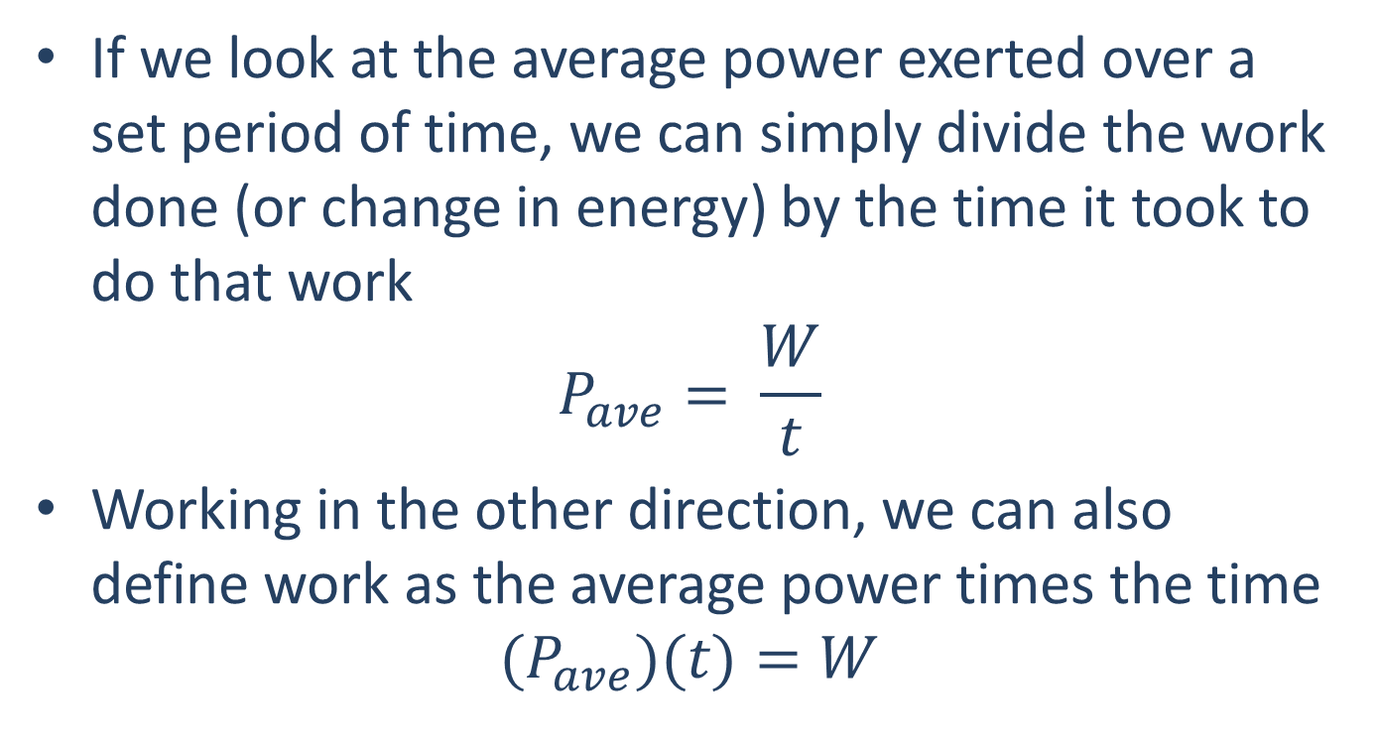
Power
If we look at the average power exerted over a set period of time, we can simply divide the work done (or change in energy) by the time it took to do that work
$$P_{ave}= \frac{W}{t}$$
Working in the other direction, we can also define work as the average power times the time
$$(P_{ave})(t)=W$$

Slide 4
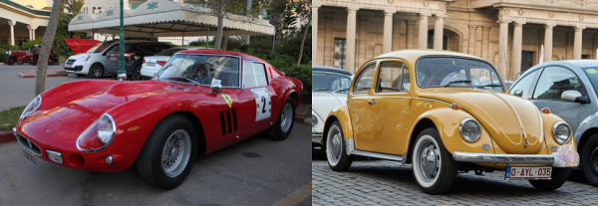
Power
In examining the impact of power, we can imagine the two cars of similar mass shown below.
They will both take the same amount of work to go from a standstill to a set speed.
The more powerful car however will be able to make this change more quickly.

Slide 5
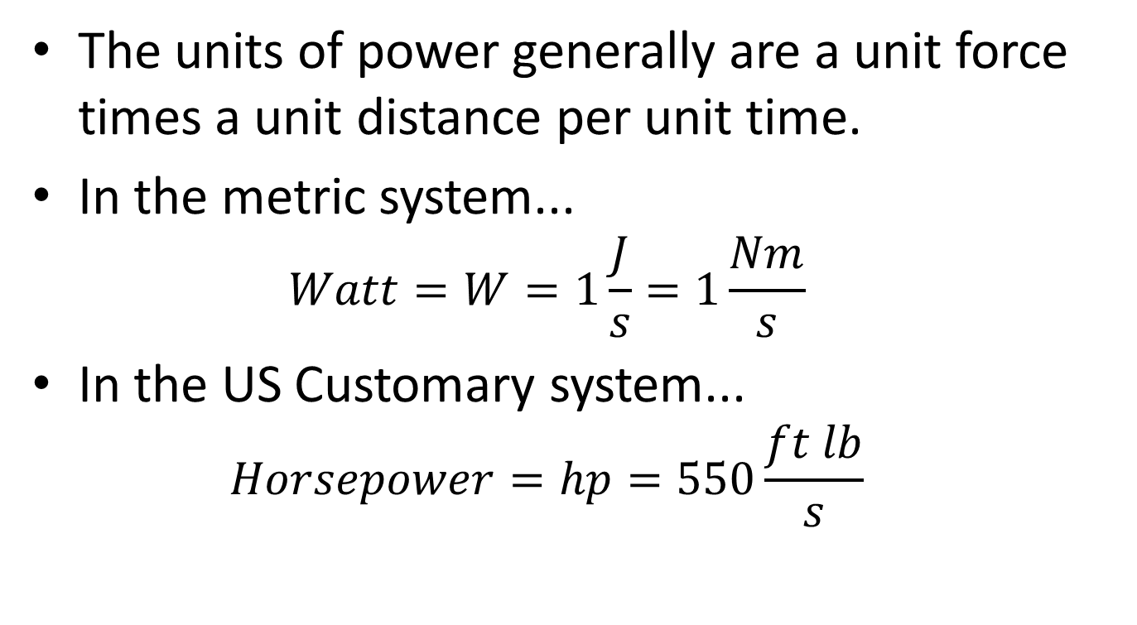
Power Units
The units of power generally are a unit force times a unit distance per unit time.
In the metric system...
$$Watt=W=1\frac{J}{s}=1\frac{Nm}{s}$$
In the US Customary system...
$$Horsepower=hp=550\frac{ft lb}{s}$$

Slide 6
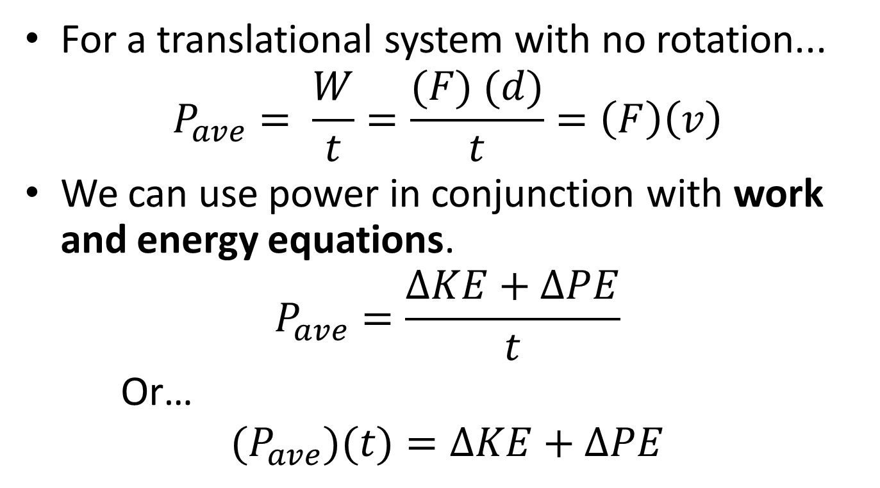
Power and Energy Equations
For a translational system with no rotation...
$$P_{ave}= \frac{W}{t}=\frac{(F) (d)}{t}=\left(F\right)\left(v\right)$$
We can use power in conjunction with work and energy equations.
$$P_{ave}=\frac{∆KE+∆PE}{t}$$
Or…
$$(P_{ave})(t)=∆KE+∆PE$$

Slide 7
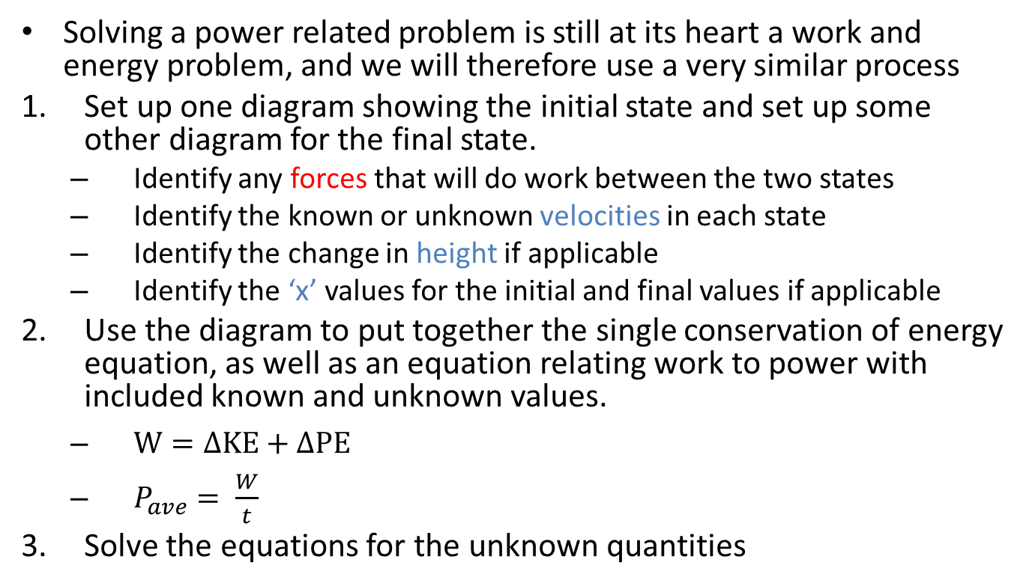
Solving Power Problems (The Process)
Solving a power related problem is still at its heart a work and energy problem, and we will therefore use a very similar process
Set up one diagram showing the initial state and set up some other diagram for the final state.
Identify any forces that will do work between the two states
Identify the known or unknown velocities in each state
Identify the change in height if applicable
Identify the ‘x’ values for the initial and final values if applicable
Use the diagram to put together the single conservation of energy equation, as well as an equation relating work to power with included known and unknown values.
$W=∆KE+∆PE$
$P_{ave}= \frac{W}{t}$
Solve the equations for the unknown quantities

Slide 8
Thanks for Watching
See other engineering mechanics videos and access the full tool at…

Slide 9

Power Worked Example
If a car delivers an average 100 hp to the road and weighs a total of 1.2 tons, how long will it take to go from 0-60 mph?

Slide 10
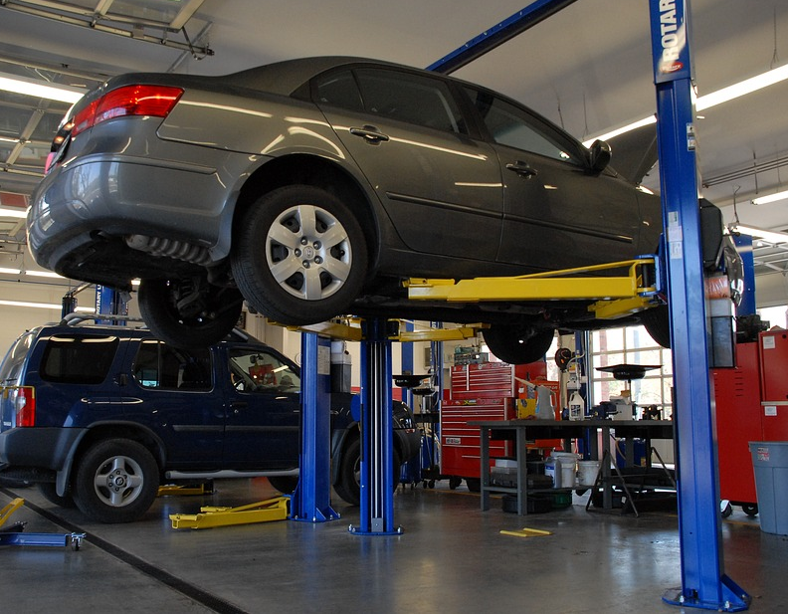
Power Practice Problem
Your car broke down and now needs to be repaired. How much power is required for a lift to raise your 1.2 ton car 6 ft off the ground in 15 seconds?

Slide 11
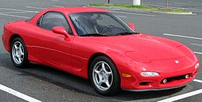
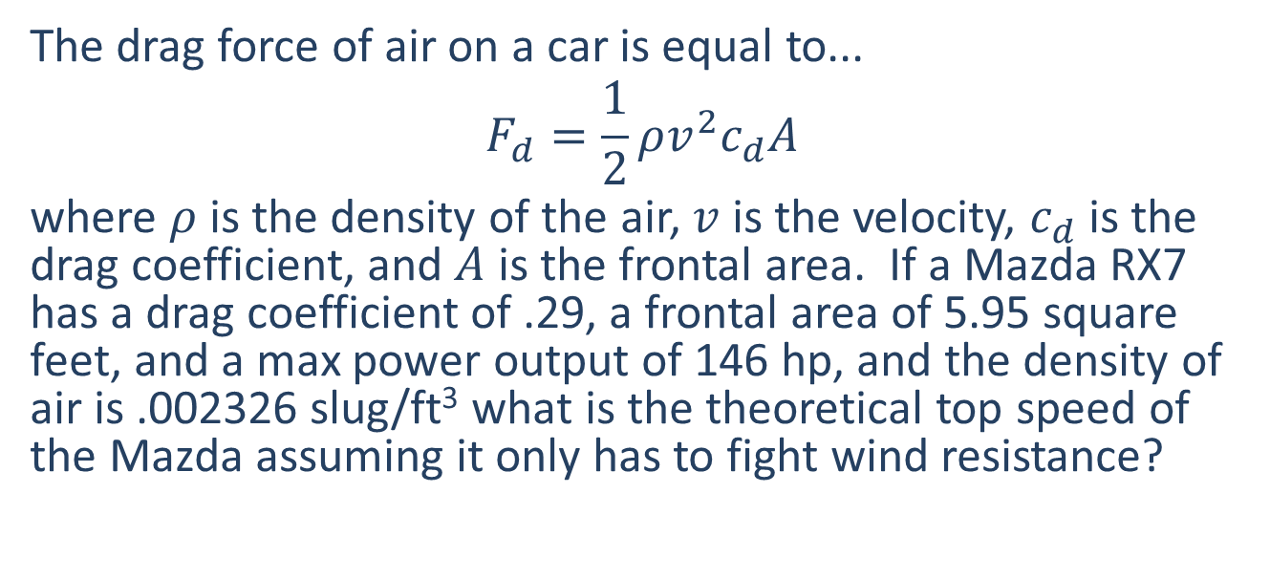
Power Practice Problem
The drag force of air on a car is equal to...
$$F_{d}=\frac{1}{2}ρv^{2}c_{d}A$$
where $ρ$ is the density of the air, $v$ is the velocity, $c_{d}$ is the drag coefficient, and $A$ is the frontal area. If a Mazda RX7 has a drag coefficient of .29, a frontal area of 5.95 square feet, and a max power output of 146 hp, and the density of air is .002326 slug/ft³ what is the theoretical top speed of the Mazda assuming it only has to fight wind resistance?

Slide 12
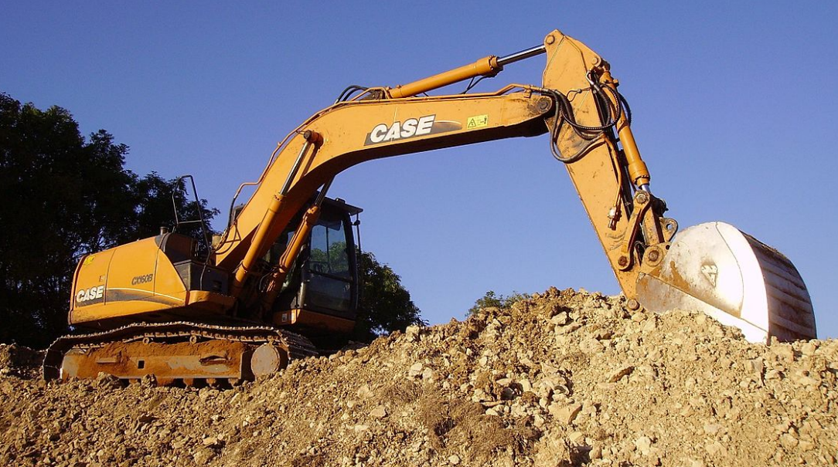
Worked Example
In a hydraulic system, a 6kN force is exerted over a 50 cm stroke length at the input piston. A 950N force is measured at the output over the 300cm stroke length. Based on these measurements, what is the efficiency of the hydraulic system?
Image by Cjp24 CC-BY-SA 3.0

Slide 13



Worked Example
A magnetic launch system exerts the force function shown below over its 80cm launch path. Assuming an 80% efficiency, what is the electrical energy we expect to have to put into the system to generate this force function?
$$F=600N$$
$$F=400N$$
x
$$x=80cm$$

